Slide 1
Wireless Security
CRYPTOGRAPHY & APPLICATION
Group 2 - 19MMT

Slide 2
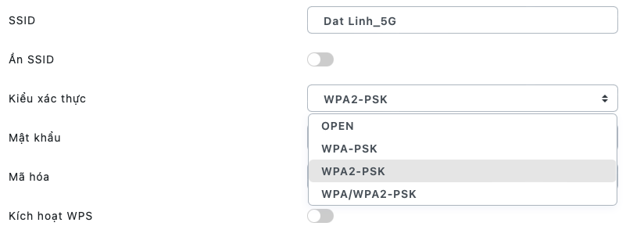
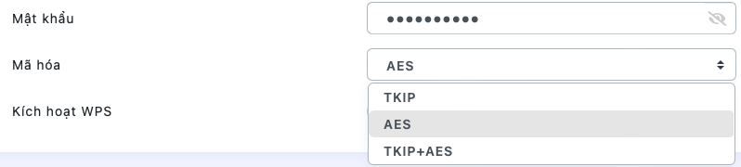

Slide 3




OUR TEAM
Tran Thien Phuc
Tran Anh Quan
Trieu Nguyen Minh Huy
Tang Thanh Quang
19127245
19127251
19127424
19127531

Slide 4
TABLE OF CONTENTS
01
02
WEP
WPA
03
04
WPA2
RSN
One of the first security protocols for Wi-Fi
A temporary solution to overcome the vulnerabilities of 802.11 in 2003
Security update of WPA
Robust Security Network

Slide 5
01
WEP
One of the first security protocols for Wi-Fi

Slide 6
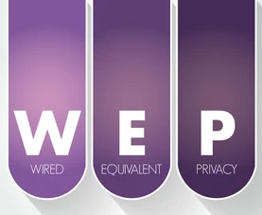
HISTORY OF WEP
Introduced in 1977
The first attempt at wireless protection
Add security to wireless networks by encrypting data

Slide 7
HOW IT WORKS?
1. Generate Initialization Vector
Ensure that the value used as a seed for the RC4 PRNG is always different
There is no guidance on how to implement IVs
Forced to repeat IVs, and violate RC4’s cardinal rule of never repeating keys

Slide 8
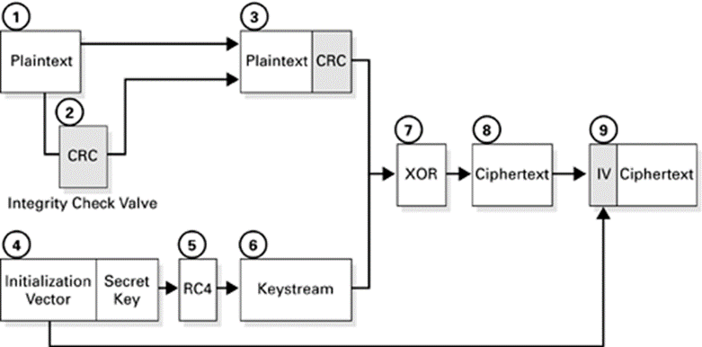
HOW IT WORKS?
2. Encryption

Slide 9
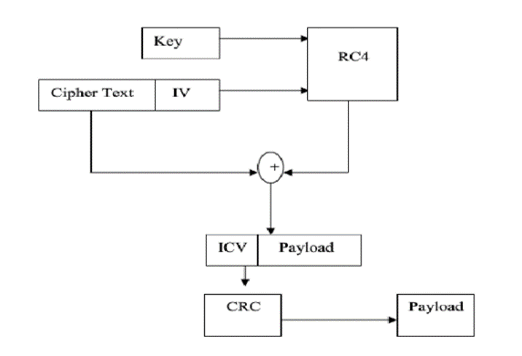
HOW IT WORKS?
3. Decryption

Slide 10
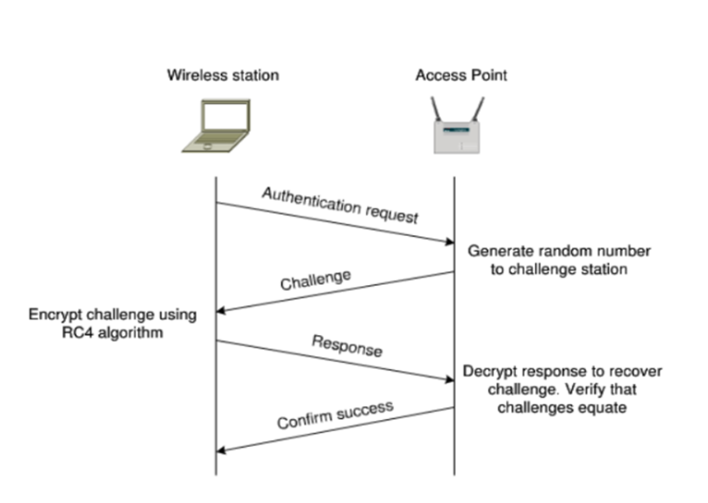
HOW IT WORKS?
4. Authentication
In Shared Key authentication, the WEP key is used for authentication in a four-step challenge-response handshake:
The client sends an authentication request to the Access Point.
The Access Point replies with a clear-text challenge.
The client encrypts the challenge-text using the configured WEP key and sends it back in another authentication request.
The Access Point decrypts the response. If this matches the challenge text, the Access Point sends back a positive reply.

Slide 11
ADVANTAGE AND DISADVANTAGE
Advantage
Disadvantage
All wireless devices support basic WEP encryption
Self-synchronization
Computational and resource optimization
Reused IV
Weak keys are susceptible to attack
Message integrity checking is ineffective

Slide 12
02
WPA
A temporary solution to overcome the vulnerabilities of 802.11 by the end of 2003

Slide 13
WPA TO THE RESCUE!
TKIP (Temporal Key Integrity Protocol)
addresses these weaknesses:
Replay attacks
Forgery attacks
IVs can be used out of order
ICV using 32-bit CRC is linear and can be manipulated
Key collision attacks
Weak key attacks
IV collisions
RC4 stream cipher is vulnerable to FMS attacks

Slide 14
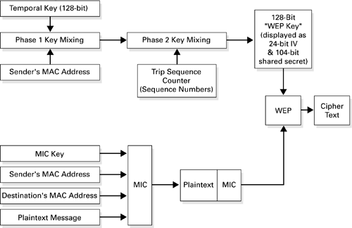
TKIP IN DETAIL

Slide 15
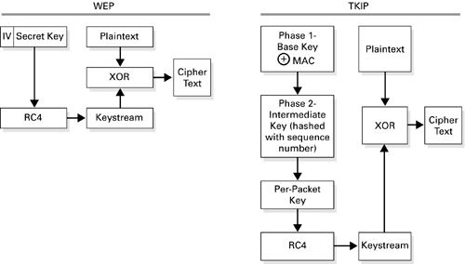
PER-PACKET KEY MIXING

Slide 16


KEY MANAGEMENT IN WPA
4-way handshake
Authentication request
Authentication response
Association request
Association response

Slide 17
ATTACK STEPS
Step 1
Step 2
Step 3
Enable observation mode
Find the network and the clients connected to it
Perform a dictionary attack

Slide 18
03
WPA2
Security update of WPA

Slide 19

INTRODUCTION
To overcome limitations of WPA, a long-term solution is to quickly develop a better security standard, more closely following the IEEE 802.11i standard, which is the WPA2 (Wi-Fi Protected Access 2) standard, which is supported by Wi-Fi. -Fi Alliance officially replaced WPA in 2006.

Slide 20
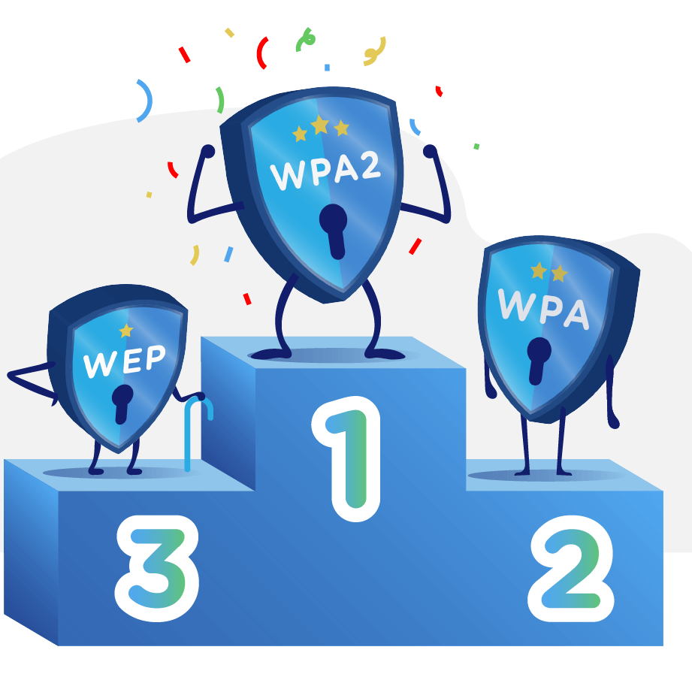
HOW IT WORKS?
Like WPA, WPA2 is designed for security on all 802.11b, 802.11a, 802.11g and 802.11n versions supporting multi-channel, multi-mode and allowing implementation over IEEE 802.11X/EAP or PSK.
It increases data security, controls network access, and overcomes all the weaknesses of WEP and WPA.

Slide 21
COMPARISON WITH WPA
WPA
WPA2
Uses TKIP (Temporal Key Integrity Protocol) for encryption and Michael’s algorithm for ensuring the integrity of each data packet
Uses AES to ensure confidentiality, data integrity and uses CCMP for data encryption and packet integrity checking

Slide 22

DISADVANTAGES OF WPA2
WPA2 requires hackers to have access to a Wi-Fi network first before they can hack into other clients on the same network.
Hackers only need to be within range of the device to be able to use the Key Reinstallation Attack (KRACK) method to penetrate the connection between the device and the hotspot.
Hackerman
Why your Internet so slow?

Slide 23
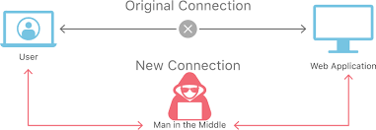
Key Reinstallation Attack
KRACK undermines an important aspect of WPA2’s 4-way handshake, allowing hackers to intercept and manipulate the generation of new encryption keys during a secure connection.
This approach allows an attacker to read any information that is supposedly encrypted.

Slide 24
04
RSN
Robust Security Network

Slide 25
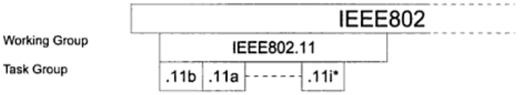
802.11 foundation
IEEE ( Institute of Electrical and Electronics Engineers ) created a group called SA (Standards Association) . IEEE-SA have responsible for creating 802 standards .

Slide 26
802.11 foundation
IEEE 802.11i define new wireless network called Robust Security Network. RSN is the same as WEP.
RSN
Transitional Security Network (TSN)
WEP

Slide 27

Definition
The Wi-Fi Alliance refers to their approved, interoperable implementation of the full 802.11i as WPA2, also called RSN (Robust Security Network)
Unlike WEP, RSN have many keys inside key architecture and most of them will not be known until the authentication process ends .
Those keys will be created after authentication process so they called temporal keys and session key . Besides, they constantly update by the time and will be deleted when the "safe situation" closed .

Slide 28
COMPARISON WITH WPA
Share architecture
WPA
RSN
More
Focus on TKIP
Specifically on one way to implement a network
Supports AES and TKIP encryption algorithms
Available ad-hoc mode
Flexibility

Slide 29
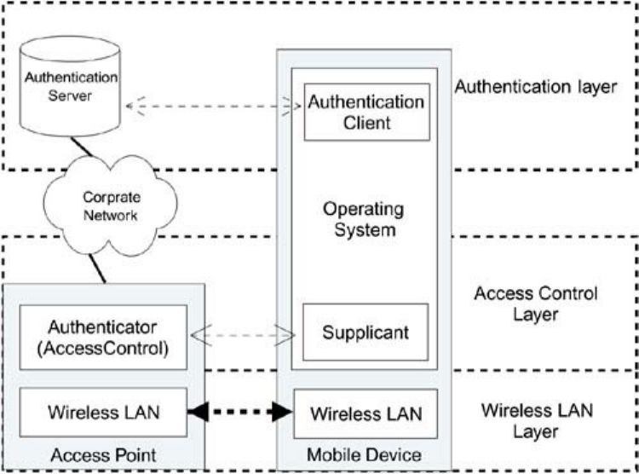
Security Layer
Wireless LAN layer
Access control layer
Authentication layer

Slide 30
DEMO ATTACK WPA/WPA2

Slide 31
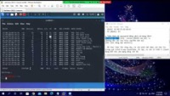
DEMO

Slide 32
RESOURCES
REFERENCES
Barken, L. (2004). How secure is your wireless network?: Safeguarding your wi-fi-lan. Prentice Hall PTR.
Nguyễn Hiếu Minh (FIT - MTA). Slide: An ninh mạng không dây (IEEE 802.11).
Nguyễn Hoàng Việt. (6.2015). Giải pháp đảm bảo an toàn mạng không dây theo chuẩn 802.11I
Wiki IEEE 802.11i-2004.
An Nhiên. (10.2017). WPA2 là gì? WPA2 đã bị hack như thế nào?
Wired Equivalent Privacy – Wikipedia.
Advantages and Disadvantages of WEP WPA Network Security - Bright Hub.
Ad-hoc network Wiki.
PHOTOS
VECTORS
Barken, L. (2004). How secure is your wireless network?: Safeguarding your wi-fi-lan. Prentice Hall PTR.
Slidesgo.com
Delesign.com

Slide 33
THANKS!
Do you have any questions?
See our report at: https://hackmd.io/@mhud/mmt_group2
Our demo video: https://youtu.be/BKpCf0WzZcg

